Slide 1
Evidence for evolution
Comparative studies

Slide 2
Biochemistry
DNA is a series of bases that acts as a code.
The greater the similarities between the genome of two organisms/species the closer they are related
This analysis can take place at a variety of levels: whole genome, mitochondrial DNA and looking at specific protein sequences

Slide 3
DNA
Speciation: When a population splits into two and eventually becomes two separate species the gene pool begins the same and slowly increases in differences until those differences are so great the two new species cannot interbreed. Once these two populations are separated permanently they will continue to diverge.
The longer the time since a common ancestor the greater the divergence occurs.

Slide 4
DNA differences between humans and great apes
Primate being compared | DNA difference (%)
Human – Chimpanzee | 1.2
Chimpanzee – Gorilla | 1.2
Human – Gorilla | 1.4
Chimpanzee – orang-utan | 1.8
Human – orang-utan | 2.4
Gorilla – orang-utan | 2.4

Slide 5
Primate % similarity of DNA with human DNA
human 100
chimpanzee 97.6
gibbon 94.7
rhesus monkey 91.1
vervet 90.5
capuchin 84.2
Galago (bush babies) 58

Slide 6
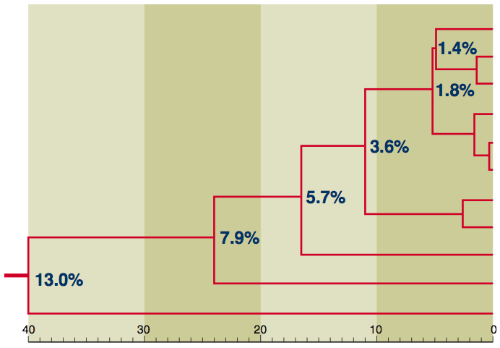
The resulting diagram based on successive splitting of divergent groups is calibrated according to these genetic differences.
A greater genetic difference implies that two groups are more distantly related
A small genetic difference would imply two groups share a recent common ancestor (where the split occurs).
Split
Human
The percentages next to each of the points where a split occurs indicates the amount of genetic difference in the total genomes of the two groups being considered.
Split
Bonobo
Common Chimpanzee
Split
Western Gorilla
Eastern Lowland Gorilla
Split
Eastern Mountain Gorilla
Split
Bornean Orang utan
Sumatran Orang utan
Split
Gibbon
Old World Monkey
New World Monkey

Slide 7
Endogenous retroviruses (ERVs)
A virus that makes RNA that can insert itself into its host’s genome
Endogenous – growing or originating from with an organism
If the retrovirus is inserted into a gamete which is forms a fertilised egg the retrovirus will be passed on.
About 8% of the human genome is made up of DNA of retrovirus origin.

Slide 8
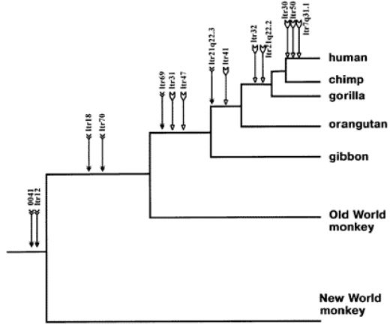
Endogenous retroviruses (ERVs)

Slide 9
Mitochondrial DNA (mtDNA)
A small amount of DNA is found in the mitochondria.
5 to 10 circular DNA molecules
37 genes: 24 for making tRNA molecules and 13 coding for the proteins required in cellular respiration
Because there are many mitochondria in a given cell (500 to 1000) there are many more copies of the mtDNA making it much easier to sequence.

Slide 10
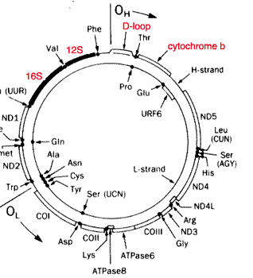
Mitochondrial DNA (mtDNA)

Slide 11
mtDNA and Neanderthals
Recently the complete mtDNA has been sequenced allowing comparison with modern humans.
Scientists have concluded that the two groups diverged about 600 000 years ago.

Slide 12
Protein sequences
Ubiquitous proteins: Proteins that appear in all species. For example cytochrome c (required in cellular respiration). These proteins carry out the same function no matter what organism they are found in.
Using modern biochemical techniques scientists can determine the amino acid sequence or target and focus on the nucleotide base sequence.

Slide 13
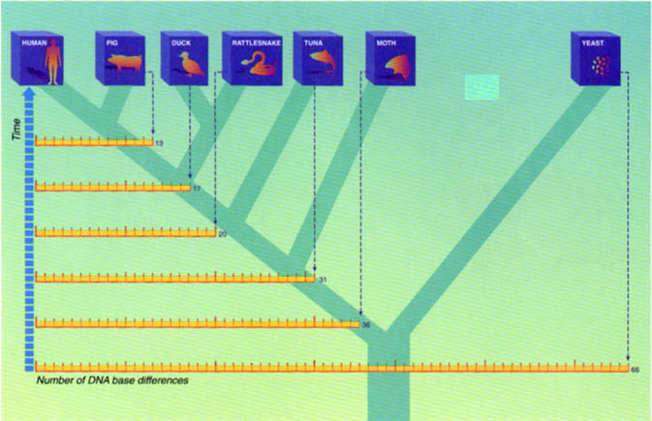
Protein sequences

Slide 14
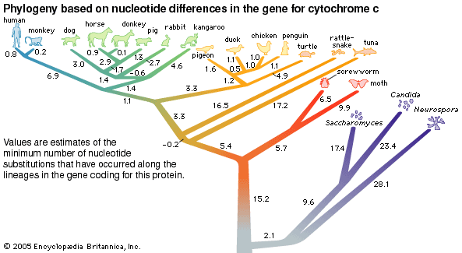
Protein sequences

Slide 15
Bioinformatics
Combination of biological science and computer science
Involves the process of annotation – identifying genes within a DNA sequence
Can be done through knowing the start and stop codon of genes

Slide 16
Comparative Genomics
Mapping the genome of different species
Through knowing what the genome of different species looks like, we can the compare them to search for similarities of differences
Link closely with comparative studies of DNA and protein sequences

Slide 17
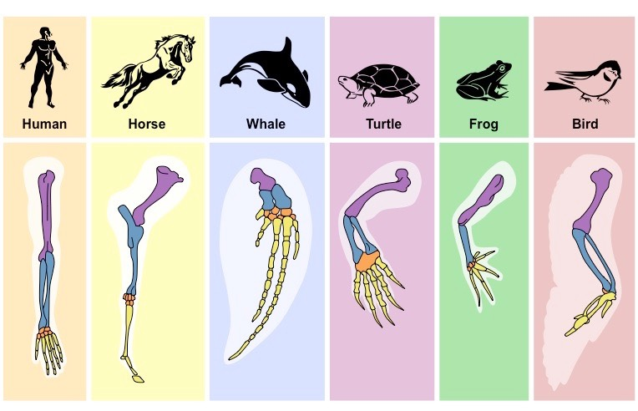
Compare a pair.
To give an account of similarities and differences between two or more items, referring to both (or all) throughout.

Slide 18
Comparative studies in anatomy
Involves comparing structural features of related animals. Helps to determine the levels of similarities and may suggest that two species share a common ancestor.
Three areas:
Embryology: comparing the early stages of development of organisms
Homologous organs: organs that are similar in structure but used in different ways
Vestigial organs: organs that have lost or changed their function.

Slide 19
Comparative embryology
In vertebrates, comparing the embryonic stages reveal a remarkable similarity between different species at different times.
Early embryos have a gill pouch and a well developed tail with no appendages.
At this same time they all have a two-chambered heart and similar brain development. Strong evidence for common ancestry.

Slide 20
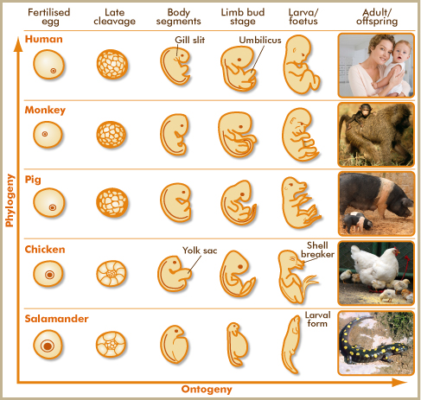
Comparative embryology

Slide 21
Homologous structures
The forelimb of vertebrates have a very similar structure.
The bones are arranged in a similar way however they have evolved/adapted for different functions.
Organisms possessing organs that are similar in structure are likely to have a common ancestor.

Slide 22
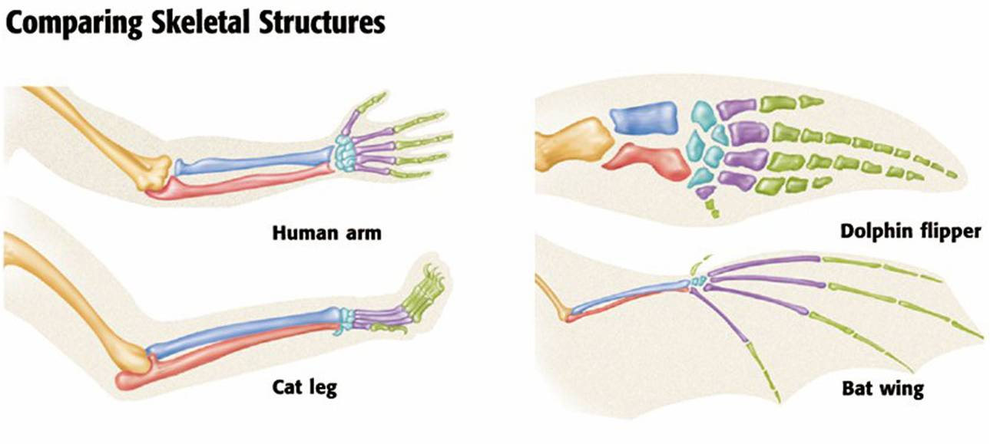
Homologous structures

Slide 23
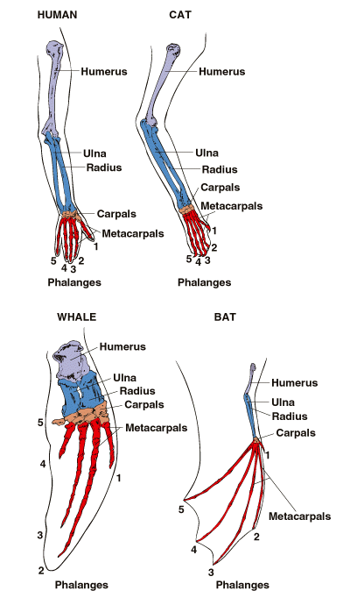
Homologous structures

Slide 24
Vestigial organs
Structures of reduced size that appear to have no function
Some of these structures may retain lesser functions or develop new ones.
These structures are what remain of organs that were functional in ancestral forms. They are not harmful and have not been eliminated.

Slide 25
Vestigial organs – human examples
Nictitating membrane – transparent third eye-lid found in cats, birds and frogs. Humans have only a pinkish membrane at the inner corner of the eye.
The third molars – erupt abnormally and cannot be used in mastication. One fifth of the population do not develop them.
Coccyx – the fused vertebrate for a tail
Muscles at base of hairs. Mammals with fur, pull the hair upright creating a layer of insulating air to protect against the cold. Human hair is to fine to function in this way and the contraction of muscles is seen as goose bumps

Slide 26
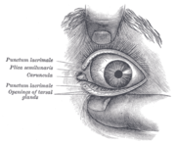
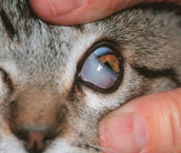
Vestigial organs – human examples

Slide 27
Vestigial organs – other vertebrate examples
The wings of flightless birds. Cannot function to fly and feathers are fluffy.
Whales and snakes still retain a pelvis and femur (fossil evidence suggests that early whales and early snakes had limbs)

Slide 28
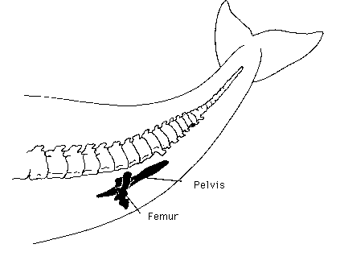
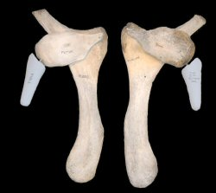
Vestigial organs

Slide 29
Comparing related species in light of geographical distribution
Isolated land areas or island groups have evolved their own distinctive plant and animal populations.
Australia: egg laying marsupials
Galapagos island finches have evolved into 13 unique species different from the mainland finch.

Slide 30
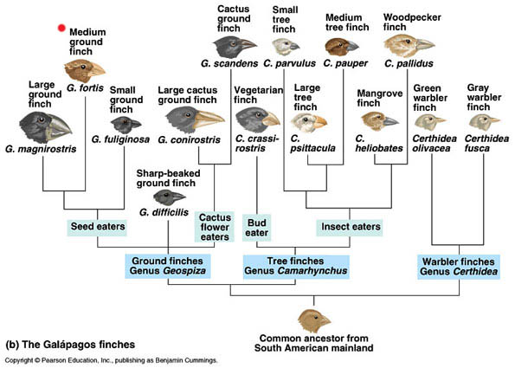
Galapagos finches

